Slide 1

Blockchain
Sunitha R
Department of Computer Science and Engineering

Slide 2

Blockchain
Consensus Algorithms: RAFT
Sunitha R
Department of Computer Science and Engineering

Slide 3
Blockchain
Consensus Algorithm – RAFT
Designed as an alternative to Paxos
A generic way to distribute a state machine among a set of servers
Ensures that every server agrees upon same series of state transitions
Basic idea:
The nodes collectively selects a leader; others become followers
The leader is responsible for state transition log replication across the followers

Slide 4
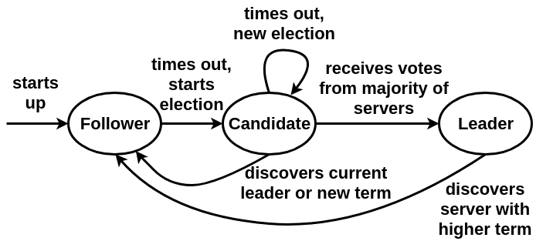
Blockchain
Consensus Algorithm – RAFT
(re)electing a leader
committing multiple values to the transaction log
dealing with replicas failing
Courtesy:Diego Ongaro and John Ousterhout, In Search of an Understandable Consensus Algorithm, Stanford University, February 22, 2014.

Slide 5
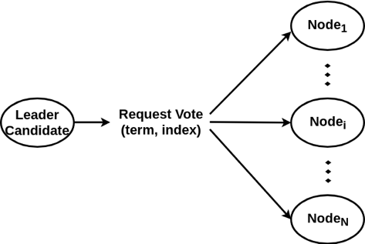
Blockchain
Consensus Algorithm – RAFT
Electing the Leader: Voting Request
term: last calculated # known to candidate + 1
index: committed transaction available to the candidate

Slide 6
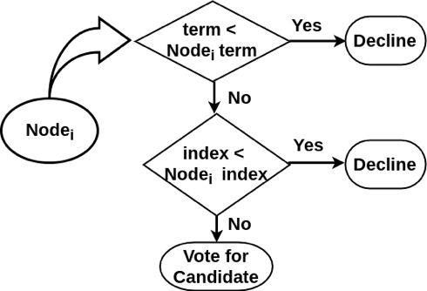
Blockchain
Consensus Algorithm – RAFT
Electing the leader: Follower Node’s Decision Making
Each node compares received term and index with corresponding current known values

Slide 7
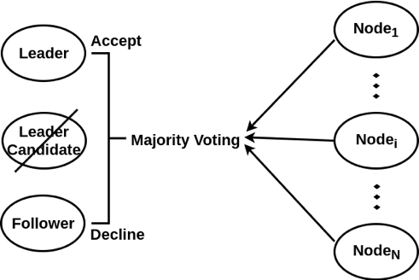
Blockchain
Consensus Algorithm – RAFT
Electing the leader: Majority Voting
Use of Majority voting
leader selection
commit the log entry

Slide 8
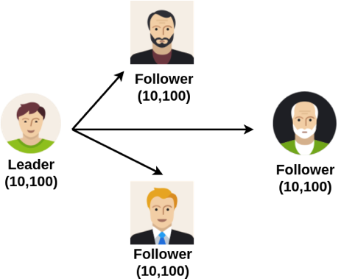
Blockchain
Consensus Algorithm – RAFT
Multiple Leader Candidates: Current Leader Failure
A leader with three followers
term: 10
commit index: 100

Slide 9
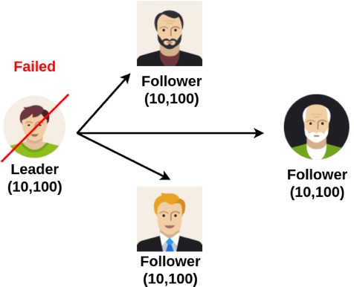
Blockchain
Consensus Algorithm – RAFT
Multiple Leader Candidates: Current Leader Failure
The leader node failed

Slide 10
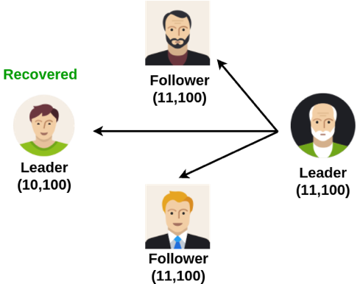
Blockchain
Consensus Algorithm – RAFT
Multiple Leader Candidates: Current Leader Failure
New leader elected with term 11
Old leader recovered

Slide 11
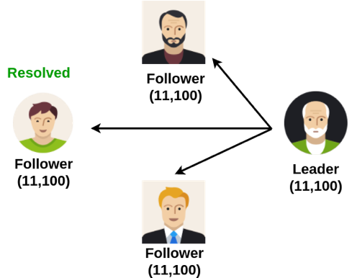
Blockchain
Consensus Algorithm – RAFT
Multiple Leader Candidates: Current Leader Failure
Old leader receive heartbeat message from new leader with greater term
Old leader drops to follower state

Slide 12
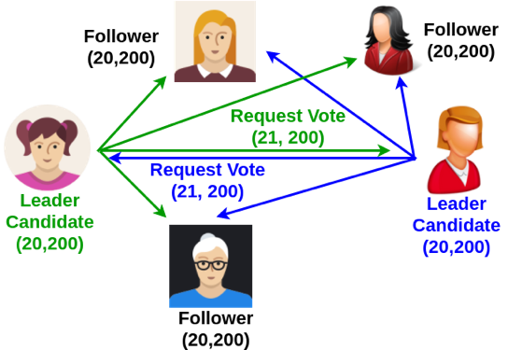
Blockchain
Consensus Algorithm – RAFT
Multiple Leader Candidates: Simultaneous Request Vote
Two nodes send Request vote message with term 21 at the same time

Slide 13
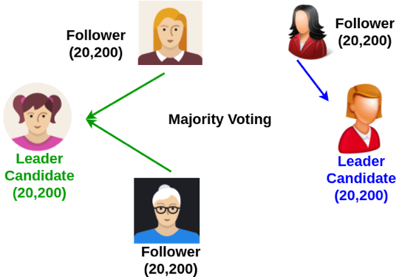
Blockchain
Consensus Algorithm – RAFT
Multiple Leader Candidates: Simultaneous Request Vote
One of them gets majority voting

Slide 14
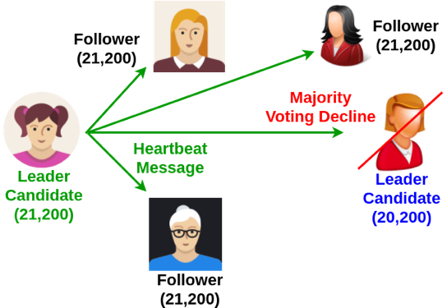
Blockchain
Consensus Algorithm – RAFT
Multiple Leader Candidates: Simultaneous Request Vote
Winner sends heartbeat message

Slide 15
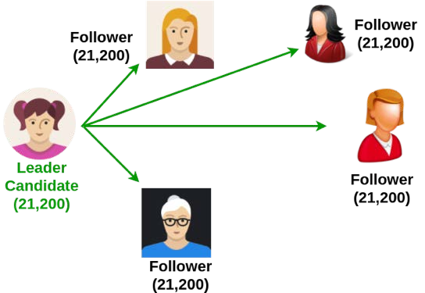
Blockchain
Consensus Algorithm – RAFT
Multiple Leader Candidates: Simultaneous Request Vote
Other leader candidate switches to follower state

Slide 16
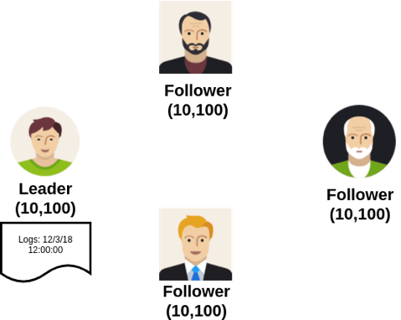
Blockchain
Consensus Algorithm – RAFT
Commiting Entry Log
Leader adds entry to log with term 10 and index 101

Slide 17
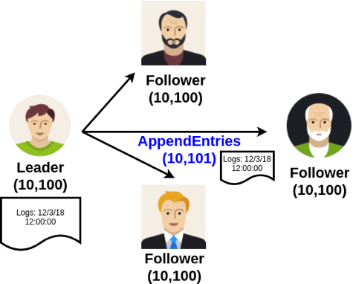
Blockchain
Consensus Algorithm – RAFT
Commiting Entry Log
Leader sends AppendEntries message to followers with index 101

Slide 18
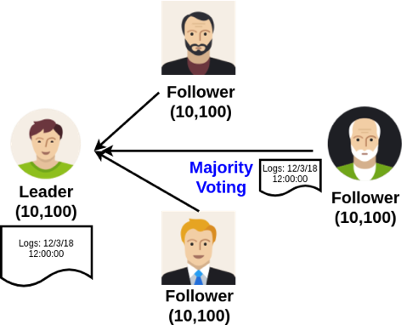
Blockchain
Consensus Algorithm – RAFT
Commiting Entry Log
Majority voting decides to accept or reject the entry log

Slide 19
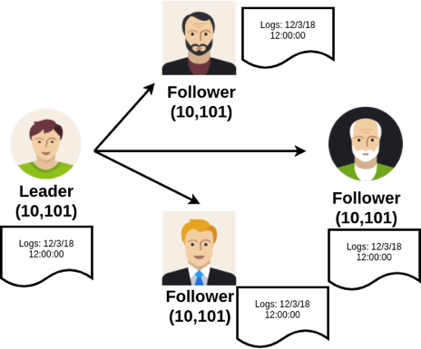
Blockchain
Consensus Algorithm – RAFT
Commiting Entry Log
Successfully accept entry log
– All leader and followers update committed index to 101

Slide 20
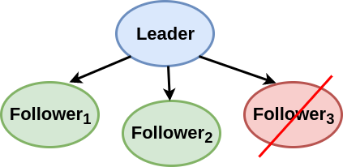
Blockchain
Consensus Algorithm – RAFT
Handling Failure
Failure of up to N/2 - 1 nodes does not affect the system due to majority voting

Slide 21
Blockchain
Supplementary Readings
https://ieeexplore.ieee.org/document/8666147
https://ieeexplore.ieee.org/document/8671595
https://ieeexplore.ieee.org/document/8962479
https://ieeexplore.ieee.org/document/8975872
https://ieeexplore.ieee.org/search/searchresult.jsp?newsearch=true&queryText=Raft%20Consensus

Slide 22
THANK YOU
Sunitha R
Department of Computer Science and Engineering
sunithar@pes.edu

